Slide 1
COMPARING AND CONTRASTING THINGS
Presented by: GROUP 4

Slide 2
—Group 4
Tionusa Catur Pamungkas (2341720093)
Tyara Kusuma Nevada (2341720019)
Dandi Azrul Syahputra (2341720118)

Slide 3
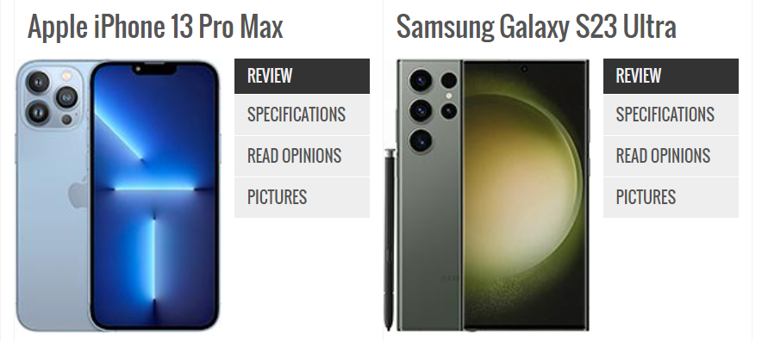
Apple iPhone 13 Pro Max
Samsung Galaxy S23 Ultra
Source: https://www.gsmarena.com/compare.php3?idPhone2=12024&idPhone1=11089#diff-

Slide 4
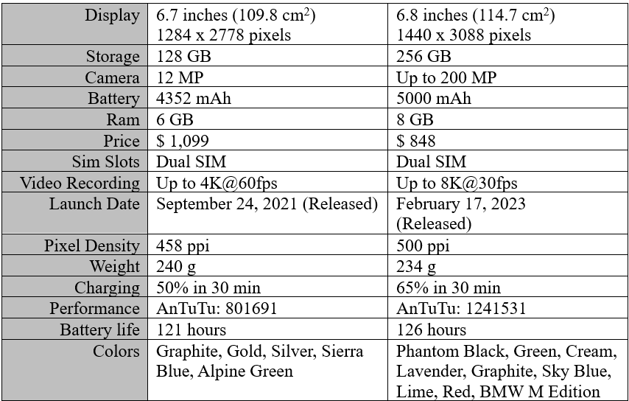

Slide 5
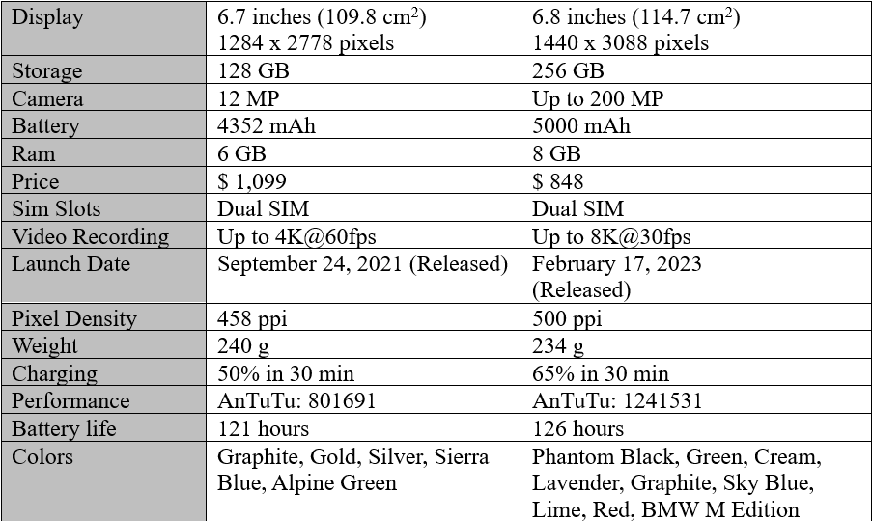
01
First, for the display, the Samsung is bigger than the iPhone

Slide 6
02
Second, iPhone storage is smaller than Samsung storage

Slide 7
03
Samsung cameras have higher resolution than iPhones

Slide 8
04
iPhone batteries tend to be lower than Samsung

Slide 9
05
Samsung Galaxy S23 Ultra Ram is bigger than iPhone 13 Pro Max

Slide 10
06
For the price, the iPhone is certainly more expensive than the Samsung

Slide 11
07
Samsung Galaxy S23 Ultra and iPhone 13 Pro Max both have Dual SIM slots

Slide 12
08
Samsung's video recording quality is better than the iPhone because the Samsung can reach 8K while the iPhone can only reach 4K in terms of video quality.

Slide 13
09
The iPhone launch date is older than Samsung because iPhone was released in 2021 while Samsung was only released in 2023

Slide 14
10
Samsung is better than iPhone in terms of pixel density because Samsung can touch 500 PPI while iPhone can only touch 458 PPI. This affects the quality of the image displayed.

Slide 15
11
iPhone 13 Pro Max is slightly heavier than Samsung Galaxy S23 Ultra

Slide 16
12
Samsung Galaxy S23 Ultra has faster charging than iPhone 13 Pro Max

Slide 17
13
Samsung Galaxy S23 Ultra AnTuTu benchmark has higher score than iPhone 13 Pro Max

Slide 18
14
Samsung Battery life has a longer Battery Life than iPhone 13 Pro Max

Slide 19
15
Samsung Galaxy S23 Ultra offers more diverse range of a color options than iPhone 13 Pro Max

Slide 20
CONCLUSION
Samsung Galaxy S23 Ultra generally offers better specifications than iPhone 13 Pro Max. However, individual preferences may vary, many factors could influence the choice between these two smartphones

Slide 21
THANKS!
Do you have any questions?

